Slide 1
Unsupervised
Machine Learning
Eng- Mohamed Khaled Idris
Eng- Mayar Swilam

Slide 2
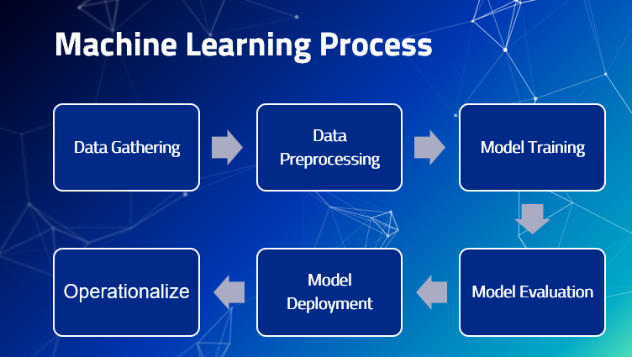

Slide 3
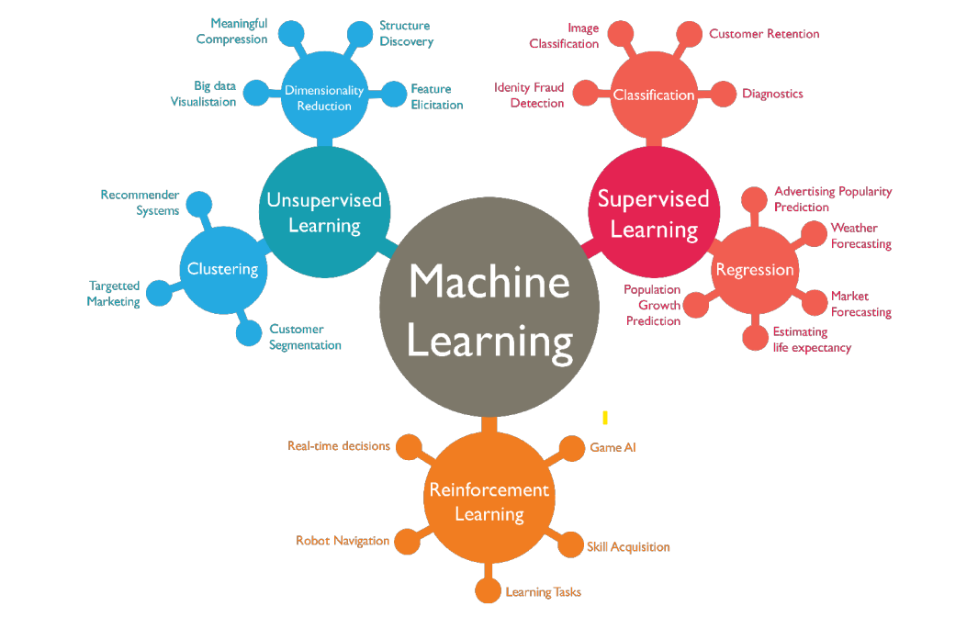

Slide 4
Unsupervised Machine Learning

Slide 5
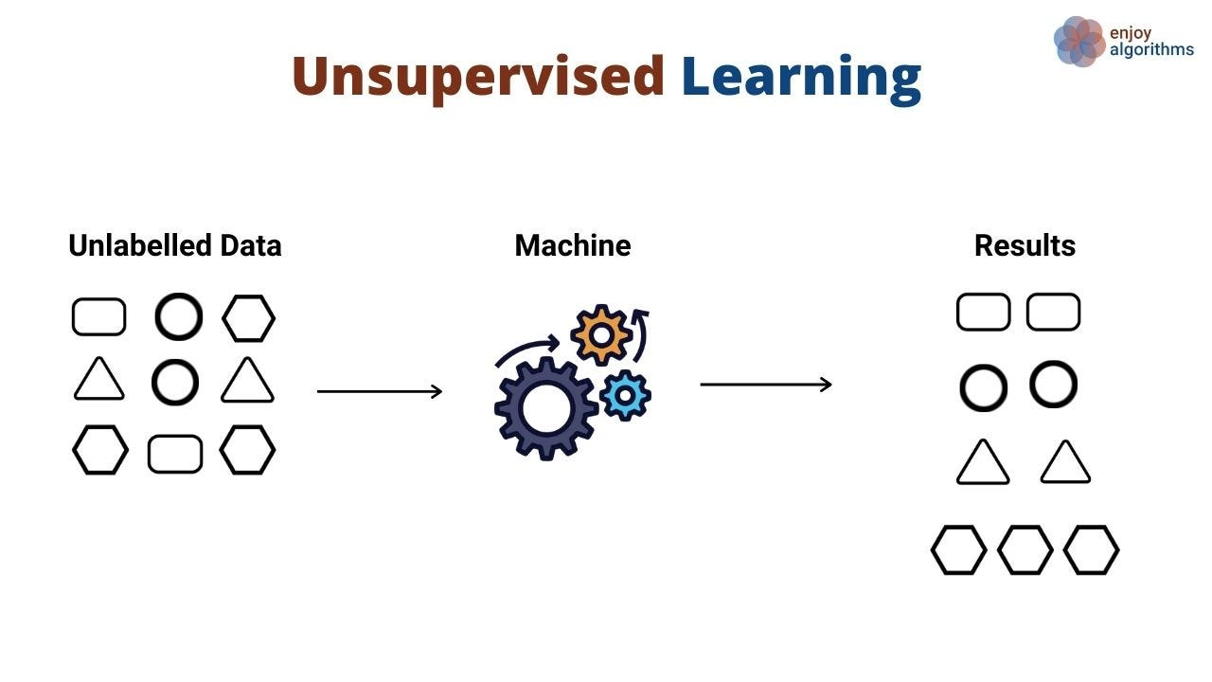
What is Unsupervised Machine Learning ?

Slide 6
Unsupervised Machine Learning
Unsupervised machine learning is a branch of machine learning where the goal is to uncover patterns, relationships, or structures within a dataset without the presence of explicit target labels or predefined outcomes.
Unlike supervised learning, which involves training a model to make predictions based on labeled data, unsupervised learning focuses on finding inherent structures or groupings within the data itself.

Slide 7
Types of Unsupervised Machine Learning
Clustering
Dimensionality Reduction
Clustering is the task of grouping a set of objects in such a way that objects in the same group are more similar to each other than to those in other groups. ■ Many applications uses clustering techniques intensively like Social network analysis, Libraries
Dimensionality reduction, is the transformation of data from a high-dimensional space into a low-dimensional space so that the low-dimensional representation retains some meaningful properties of the original data. ■ Feature Selection and Feature extraction (projection).

Slide 8
Types of Unsupervised Machine Learning
Clustering
K-Means
Hierarchical Clustering
DBSCAN
Dimensionality Reduction
Principle Component Analysis (PCA)
Singular Value Decomposition (SVD)
T-Distributed Stochastic Neighbor Embedding (t-SNE)

Slide 9
Clustering
Clustering involves grouping similar data points together into clusters based on certain similarity criteria.
The Goal is to identify patterns or segments within the data.

Slide 10
Dimensionality Reduction
Dimensionality reduction techniques aim to reduce the number of features or variables in the dataset while preserving as much relevant information as possible.
This is useful for visualizing high-dimensional data, reducing noise, and speeding up subsequent analyses.

Slide 11
What is Unsupervised Learning used for ?

Slide 12
Fields of Unsupervised Learning
Data Exploration: Unsupervised techniques can help analysts understand the underlying structure of a dataset and discover relationships that might not be obvious at first glance.
Anomaly Detection: By learning the normal patterns of the data, unsupervised methods can identify unusual or anomalous observations that deviate from those patterns.
Recommendation Systems: Unsupervised techniques can be used to group similar users or items, allowing for the creation of recommendation systems that suggest products.
Feature Engineering: Dimensionality reduction techniques can assist in reducing the complexity of a dataset, which can lead to simpler and more efficient models.
Text Analysis: Unsupervised learning is often used in natural language processing tasks such as topic modeling, where documents are grouped based on the topics they discuss.

Slide 13
Unsupervised Learning (Clustering)

Slide 14
Clustering
Clustering is an unsupervised machine learning technique that involves grouping similar data points together based on certain criteria.
The goal of clustering is to find natural groupings within a dataset without any predefined labels.
Each group of data points is referred to as a "cluster," and the process of creating these clusters is known as "clustering."

Slide 15
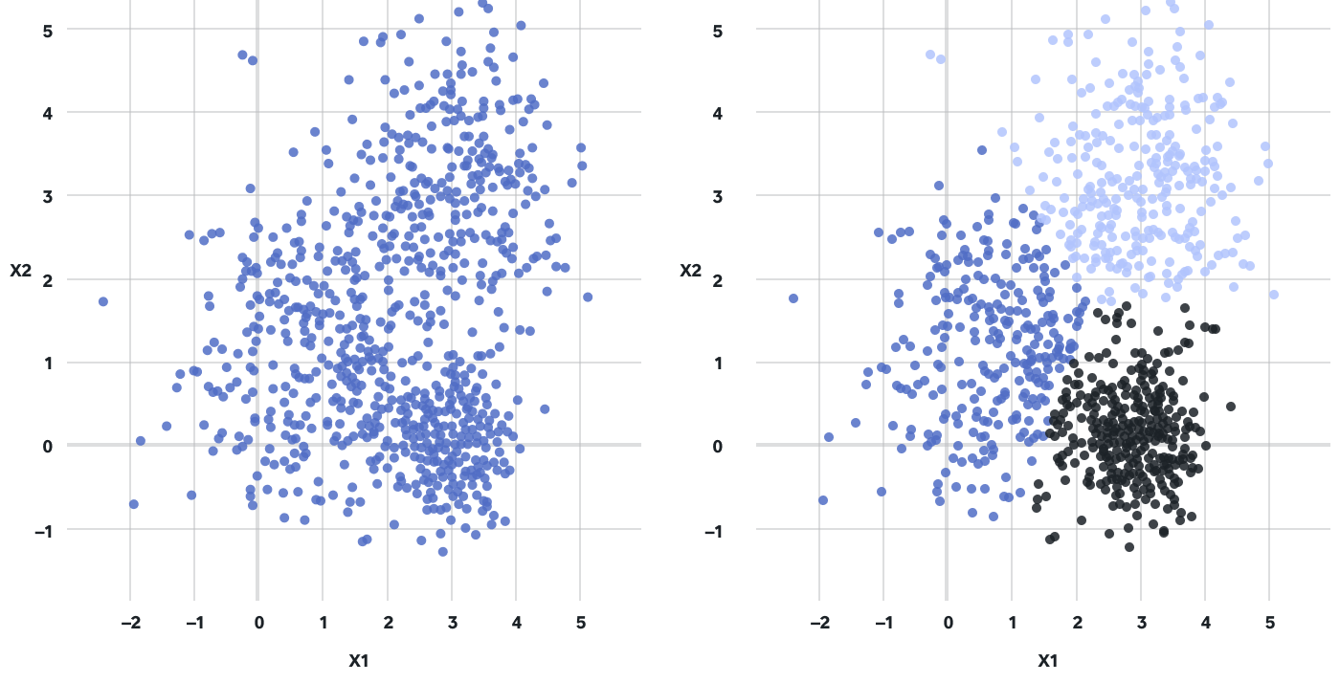

Slide 16
Algorithms for Clustering
K-Means Clustering: This algorithm partitions the data into a specified number (k) of clusters by iteratively assigning data points to the nearest cluster center (centroid).
Hierarchical Clustering: Hierarchical clustering builds a hierarchy of clusters by either starting with each data point as its own cluster and merging them or by starting with all data points in a single cluster and recursively dividing them into smaller clusters.
DBSCAN (Density-Based Spatial Clustering of Applications with Noise): DBSCAN groups together data points that are closely packed together while considering regions with lower data density as noise.

Slide 17
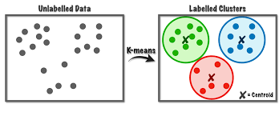
K-Means Clustering

Slide 18
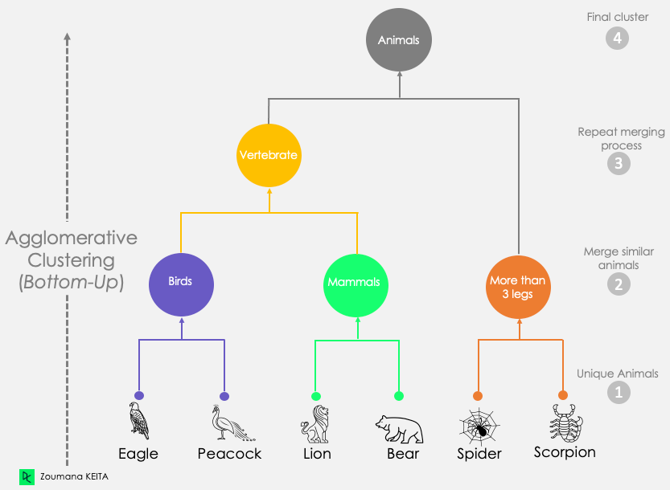
Hierarchical Clustering

Slide 19
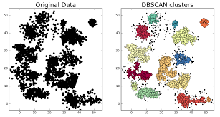
DBSCAN

Slide 20
K-Means Clustering

Slide 21
K-Means Algorithm
K-Means is one of the most widely used clustering algorithms.
It's a partitioning method that divides a dataset into a specified number of clusters (k) based on the similarity of data points.
The algorithm iteratively assigns data points to clusters and updates the cluster centers until convergence.

Slide 22
Centroid
A centroid is a CENTRAL POINT that represents a group of data points within a cluster in a clustering algorithm
the centroid serves as a reference point around which the data points in a cluster are grouped.
It's used to calculate the "center" of the cluster and is updated iteratively as the clustering algorithm progresses.

Slide 23
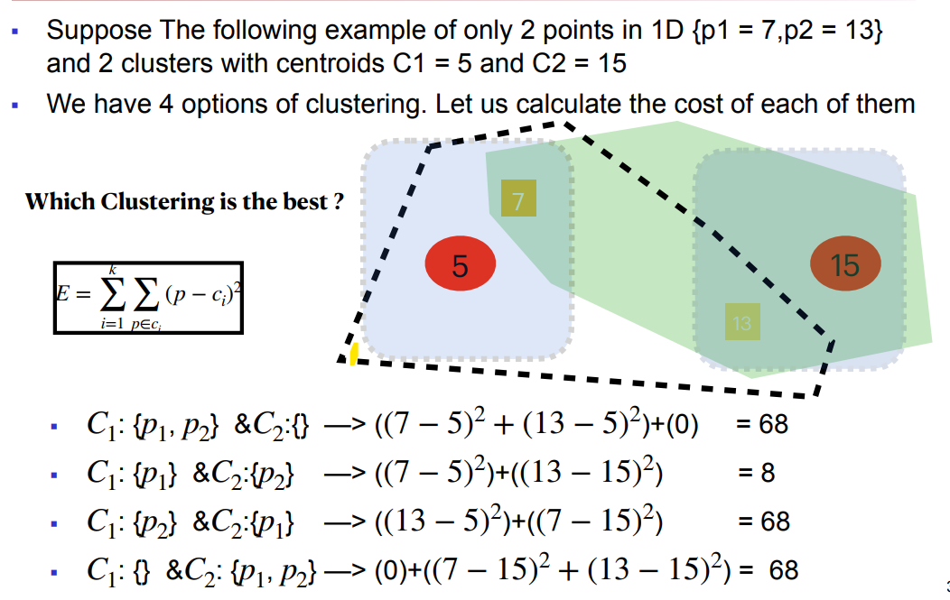

Slide 24
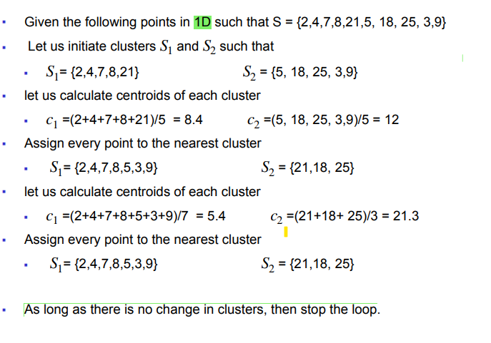
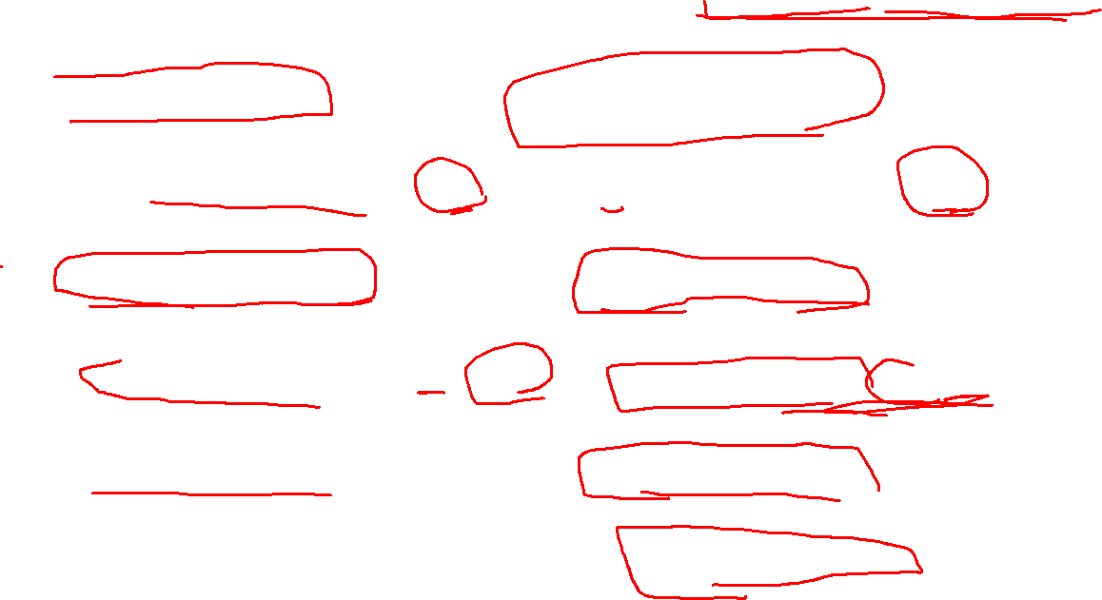

Slide 25
How it works ?

Slide 26
Initialization
Choose the number of clusters (k) you want to create.
Initialize k cluster centroids randomly by selecting k data points from the dataset. These centroids will serve as the initial cluster centers.

Slide 27
Assignment Step
For each data point in the dataset, calculate the distance (USING ANY DISTANCE METRIC) to each of the k cluster centroids.
Assign the data point to the cluster whose centroid is the closest (i.e., the cluster with the minimum distance).

Slide 28
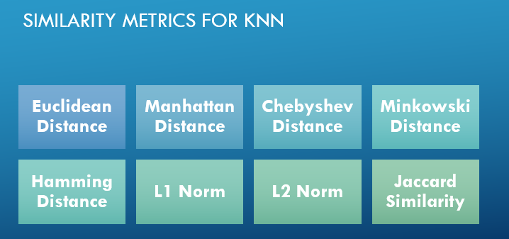
Revise: Distance Metrics

Slide 29
Update Step
After all data points are assigned to clusters, calculate the mean (average) of the data points in each cluster. This mean becomes the new centroid for that cluster.
Update the cluster centroids to be the newly calculated means.

Slide 30
Iteration
Repeat the Assignment and Update steps for a predefined number of iterations or until a stopping criterion is met.
The algorithm iteratively refines the cluster assignments and updates centroids to improve the fit.

Slide 31
Convergence
The algorithm will converge when the cluster assignments and centroids no longer change significantly between iterations.

Slide 32
How to choose the appropriate number of k?

Slide 33
Cost function of k-means
The cost function of K-Means, also known as the objective function or distortion function, quantifies how well the data points in a cluster are grouped around their respective centroids.
The goal of the K-Means algorithm is to minimize this cost function, which essentially means MINIMIZING the sum of squared distances between data points and their assigned cluster centroids.

Slide 34
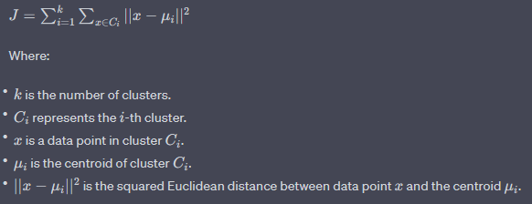

Slide 35
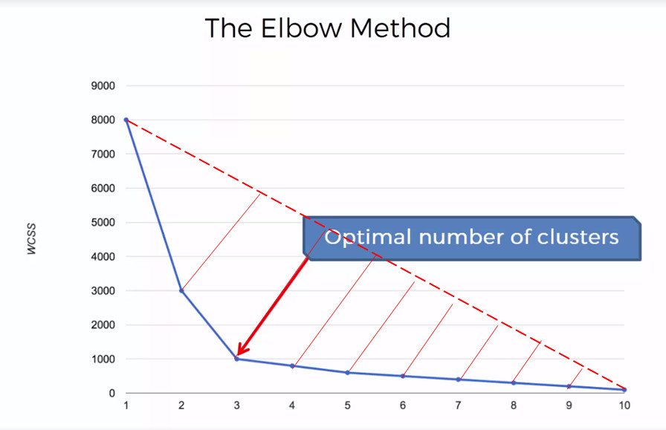
Cost function for different number of K
(Elbow Method)

Slide 36
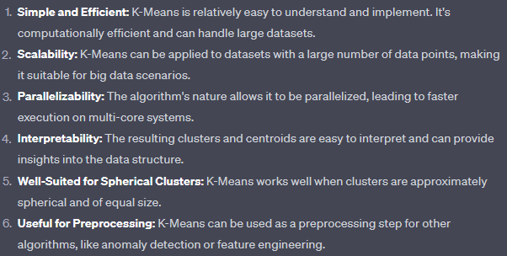
Advantages of K-Means

Slide 37
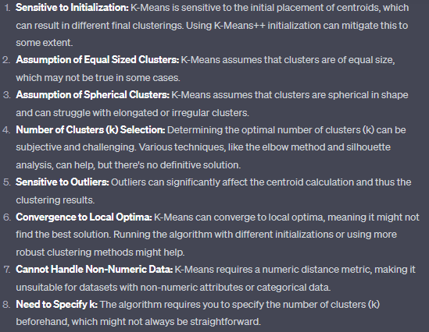
Disadvantages of K-Means

Slide 38

Questions

Slide 39
Thank you

